Slide 1
Heterochiasmy Models
Notes:
Discussion (table for interpretation)
Theme / goal of table
Start with list of universal sexual dimorphic features in gametes of anisogamus systems --- make connections / predictions to how they could effect evolution of heterochiasmy
1. Differing tension forces across bivalents in metaphase due to spindle differences
2. meiocytes volume differences affecting the efficiency of homolog pairing and non-homolog disassociations
3. Checkpoint and constraint differences
4. (stem cell populations / gonad temperature)?

Slide 2
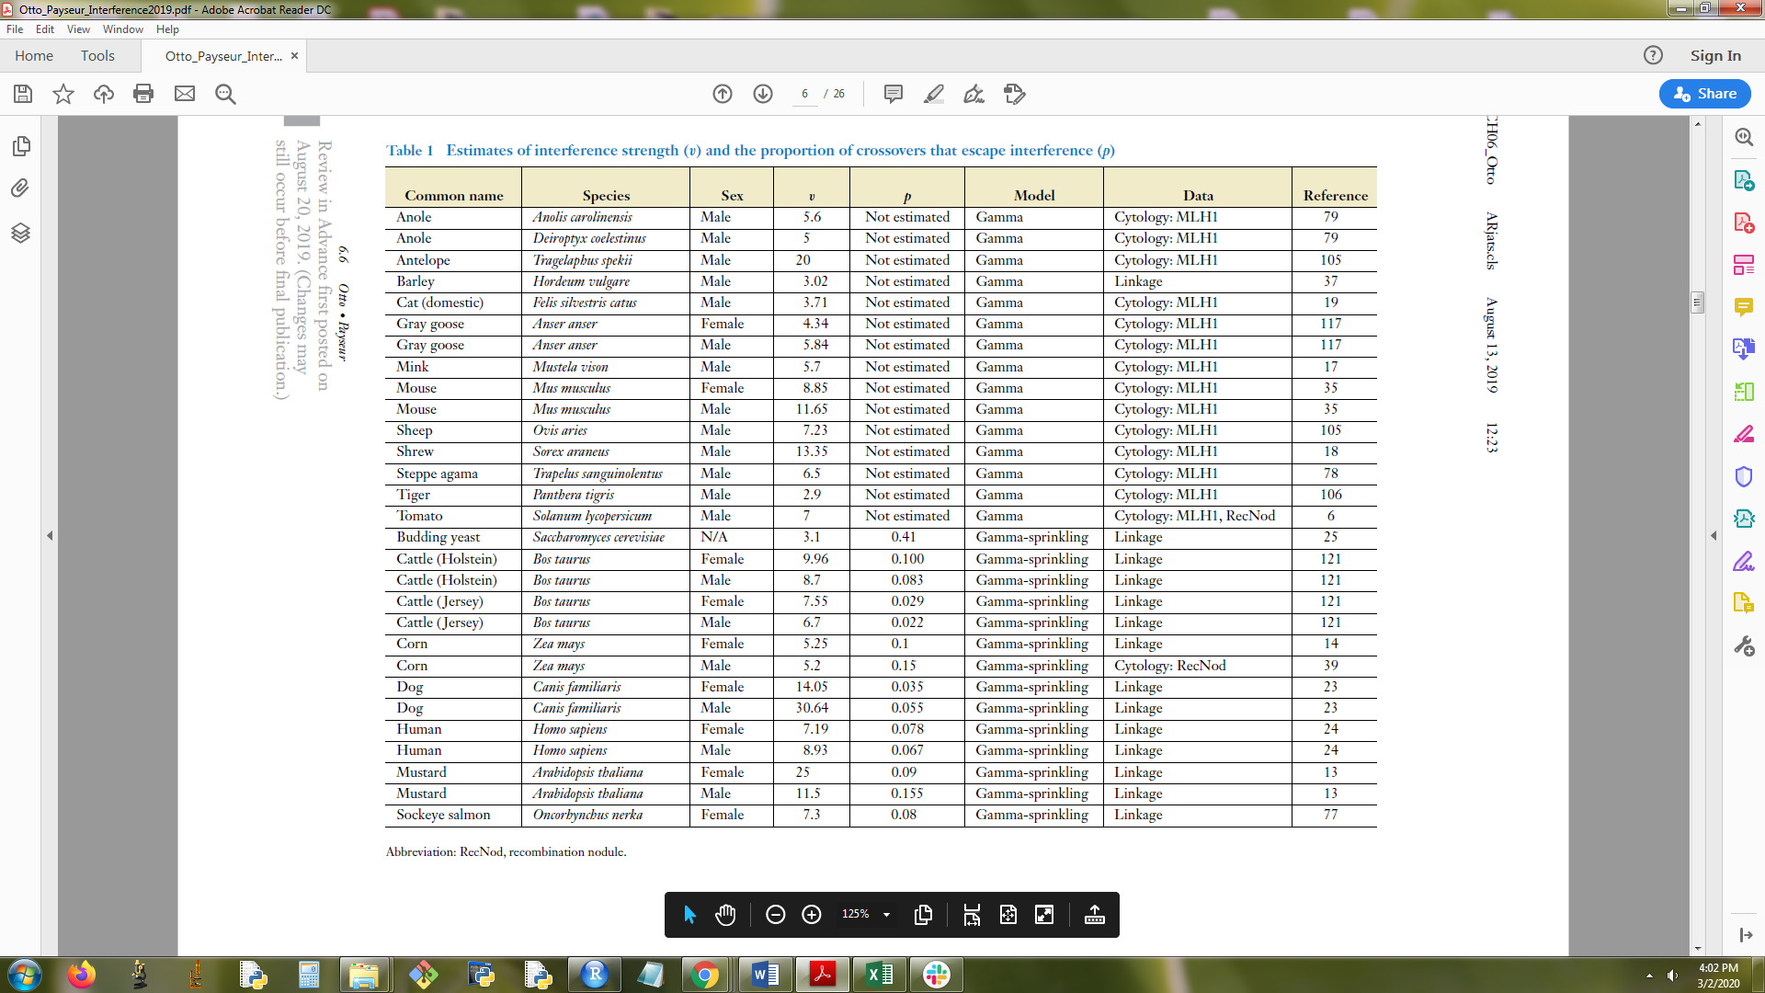
Notes:
From Payseur ottto 2019

Slide 3
Model name | References | Typical Landscape | SC compaction | Weaker female interference | Increased female within mouse variance for mlh1
Gamete selection (reduction principle) | Lenormand and Duthiel 2005 Trivers 1988 | ? |  |  | Yes
SACE | Sardell Kirkpatrick 2019 | Yes | ? | ? | Maybe
Two locus (protection against drive systems) | Brandvain Coop 2012 | Yes, (females generally higher RR and COs closer to centromeres) |  |  | (depends on the scale)
Spindle SAC differences (difference Checkpoints) | So et al 2019 **Ross and Normark 2015 Manadhar et al 2005 Scahtten Sun 2009 Schuh Ellenburg 2007 | yes | ? | Yes | yes
(Meiotic drive) Selfish centromere- MT – kinetochore attachment
Notes:
Selfish centromeres
Driving centromeres destabilize MT-KT attachment (tension) and rotate to egg side of spindle, Selfish centromeres detach MT-KT increase lack of tension across bivalent
When driving centromeres are at high frequency (or linked to deleterious alleles), less effective female SAC could be adaptive
-If metaphase delayed driving centromeres rotate to egg side and increase
-If metaphase not delayed, driving centromeres less successful.
-Detaching MT-KT, lack of tension bivalents trigger SAC (apoptosis)
-Male segregation distorters act post division
True meiotic drive systems rely on asymmetric division, mostly unique to eggs
No direct effect on RR. When driving centromeres are at high frequency (or linked to deleterious alleles), less effective female SAC could be adaptive, Akera et al 2019
Age degradation of cohesion
Oocytes with more COs have more stable bivalents and not affected by age-related lose of cohesin (not sure how this
Longer arrest in oocytes associated with cohesion loss
? reduced chromatid interference, more cohesion across 4 chromatids, (improve – tension)
No age arrest and cohesion loss
Male specific rec landscape evolves (via indirect selection)
Mammals- eggs are arrest stages can be decades. Positive corr with fertility of older females and RR
? Cohesion degradation may not necessarily select for more RR
Hassold Hunt papers
Schuh?

Slide 4
Previous Models
Model | Mechanism (indirect selection, mechanism) | Evo prediction for female | Evo prediction for male | Fit Anisogamous gamete pattern | Fits HetC pattern | References | notes
Haploid selection and modified model | -Correlation with sperm competition and heterochiasmy | default RR | Reduced RR driven by sperm competition | Male/sperm have stronger selection pressure compared to eggs | Most animals have female biased RR, holds for plants | Lenormand and Duthiel 2005 Trivers 1988
SACE Sexually antagonistic cis epistasis | -SA selection | Default Rec landscape | Lower RR and COs localized distal to centromeres, to keep SA gene blocks together | Males have more fitness variance due to SA | Predicts male telomere bias/ centromere suppression | Sardel Kirkpatrick 2019
2 locus driver system | Females evolve to disrupt meiotic drive systems | Females evo higher RR to break up drive systems (closer COs to centromeres and higher) | Default / male specific RR | True meiotic drive only in asymmetrical cell division (oocytes) | females generally higher RR and COs closer to centromeres | Brandvain Coop 2012 | Sex with drive, evolve higher RR and closer to centromere to increases chances of breaking up drive systems
Female rate and drivers (MI) 1 locus model | ? | ? | ? | ? | ? | Haig 2010
chromatin remodeler HELLS
Notes:
Sardell --- We propose a hypothesis in which both of Lenormand’s conditions can in fact be met: when there are sex differences in epistasis between coding regions and their cis regulatory regions. We refer to this idea as “sexually antagonistic cis epistasis”, or SACE.
Upregulate a color gene in males – keep high regulatory variant and the color gene close together in tight linkage (and specific to one sex?)
Haploid selection- Lenormand (2003) found that one way that sex differences in recombination can evolve is when
two conditions are met. The first is that the strength of epistasis between alleles at a pair of loci
on a chromosome depends on whether they are in a cis or trans relationship (i.e., if they are on
the same physical chromosome or on different homologues). Second, the relative strengths of the
cis and trans epistasis must differ in males and females. Lenormand (2003) thought the first
condition implausible, arguing that if two loci produce gene products, interactions between those
products is unaffected by whether their alleles are in cis or trans.

Slide 5
Prophase based models
Model | Mechanism | Evo prediction for female | Evo prediction for male | Anisogamous Gamete pattern | HetC pattern | Citations | notes
Membrane differences by Temp Or chrm axis / SC differences by temp | Membrane or phase separated structures in meiosis (NE, RPM , SC), have difference stiffness at difference temperatures | Higher temp at gonad devo less stiff NE and/or chromosome axis Longer axis | Lower temp – stiffer Shorter propagation of | ? Mammals- oocytes devo at higher temp Sperm devo at lower temp (Temperature dependent sex determination?) | ? Temperature effects on RR | ? Plough 1917; Plough 1921; Phillips et al. 2015 Miles 2004? | -Crocodiles -HetC will be greater in species with different temperatures of gamete development
Cell volume and homolog pairing | At bouquet stage chrms need space during the RPM for correct homologs to pair and ectopic associations to be shaken out. | Larger cell vol requires longer axis to tether telomeres NE | Smaller cell vol drive shorter axis to reach NE and axis length is limited so ectopic pairing can come apart. | Oocytes larger than spermatocytes | Females usually have longer chrm axis / SC | -Wallace and Fung 2019 Campos-Ramos 2009 (fish SC), some fish do not have longer SC in female | Positive correlation with cell volume -> axis length -> RR
Notes:
Zelazowski, M. J., Sandoval, M., Paniker, L., Hamilton, H. M., Han, J., Gribbell, M. A., ... & Cole, F. (2017). Age-dependent alterations in meiotic recombination cause chromosome segregation errors in spermatocytes. Cell, 171(3), 601-614.
Marshall, Wallace F., and Jennifer C. Fung. "Modeling meiotic chromosome pairing: a tug of war between telomere forces and a pairing-based Brownian ratchet leads to increased pairing fidelity." Physical biology 16.4 (2019): 046005.
Lane, S., & Kauppi, L. (2019). Meiotic spindle assembly checkpoint and aneuploidy in males versus females. Cellular and molecular life sciences, 76(6), 1135-1150. **good review, good figures SAC
Subramanian and hochwagen 2014 – great review on the meiotic checkpoint network (MCN) ATM and ATR main players signals
Paouneskou, Dimitra, and Verena Jantsch. "Meiotic chromosome movement: what’s lamin got to do with it?." Nucleus 10.1 (2019): 1-6.
“Thus, we concluded that a more rigid lamina network causes stochastic chromosome damage in the prophase of meiosis I, and that the resultant compromised oocytes are efficiently culled by the apoptotic machinery.”

Slide 6
Metaphase based models
Model | Mechanism | Evo prediction for female | Evo prediction for male | Anisogamous Gamete pattern | HetC pattern | Citations | notes
Selection on bivalent structure (via spindle or SAC) Metaphase spindle | Metaphase bivalent structure is target of selection | Relaxed selection on biv str more bivalent classes Variable CO position Weaker interference | Purifying selection on biv str Fewer bivalent classes (1CO and 2CO) Restricted CO positions (middle and ends) Stronger interference | Acentrosome spindle in females (universal) Acentrosomic and centrosomic spindles are universal in oocytes and spermatocytes | Uniform CO distribution in females, highly localized (male) -Telomeric bias across most chromosomes -More 0CO in females | So et al 2019 **Ross and Normark 2015 Manadhar et al 2005 Scahtten Sun 2009 Schuh Ellenburg 2007 | More divergence of RR across species in males (opportunity for directional selection) Doesn’t necessarily predict higher RR in females
(Meiotic drive) Selfish centromere- MT – kinetochore attachment | Driving centromeres destabilize MT-KT attachment (tension) and rotate to egg side of spindle Selfish centromeres detach MT-KT increase lack of tension across bivalent | -If metaphase delayed driving centromeres rotate to egg side and increase -If metaphase not delayed, driving centromeres less successful. | -Detaching MT-KT, lack of tension bivalents trigger SAC (apoptosis) -Male segregation distorters act post division | True meiotic drive systems rely on asymmetric division, mostly unique to eggs | No direct effect on RR | Akera et al 2019 | When driving centromeres are at high frequency (or linked to deleterious alleles), less effective female SAC could be adaptive
Age degradation of cohesion | ?reduced chromatid interference Oocytes with more COs have more stable bivalents and not affected by age-related lose of cohesin | Longer arrest in oocytes associated with cohesion loss ? reduced chromatid interference, more cohesion across 4 chromatids, (improve – tension) | No age arrest and cohesion loss Male specific rec landscape evolves (via indirect selection) | Mammals- eggs are arrest stages can be decades. Positive corr with fertility of older females and RR | ? Cohesion degradation may not necessarily select for more RR | Hassold Hunt papers Schuh?
Notes:
Leaky SAC: (Gruhn+ Hoffman 2019), Subramanian and Hochwagen 2014, Lane, S., & Kauppi, L. (2019), Marston and Wassmann 2017?
Fitness / efficiency of checkpoint constraint is how effectively it shuts down alleles that trigger checkpoint. (that allele is removed from population) (I guess this is group level selection?)

